Slide 1


Project presentation
Chandan Biswas(17IT8008)
Laxmi Tirkey(17IT8037)
G. Bhanu Teja(17IT8053)
Shrawan Kumar Yadav(17IT8073)

Slide 2
Introduction
This project's aim is to create a desktop assistant that is simplistic and customizable.
The assistant uses speech recognition for listening to queries.
It also displays the result it finds in text format.
It speaks up the information.

Slide 3
Available Technologies
Google Voice Assistant
Siri
Cortana
Alexa
Bixby
DataBot
Robin

Slide 4
Inspiration
Other Voice Assistants
To make a simple and customizable solution
Adding some extra features
Learning

Slide 5
Features of the desktop assistant
Simple and customizable
Speech recognition
General and arithmetic logic
Offline assistance(opening files and music)
Online assistance(searching google and Wikipedia)
Weather assistance
Time and date
Tweeting on twitter
Posting on Instagram
Reading PDF files
Sending E-mails

Slide 6
First run
The assistant greets the user according to the time and takes the input from the microphone for queries.
The speech recognition and text to speech conversion is done by the pyttsx3 module.
Speech API(SAPI5) is a Microsoft provided technology for voice recognition and synthesis

Slide 7
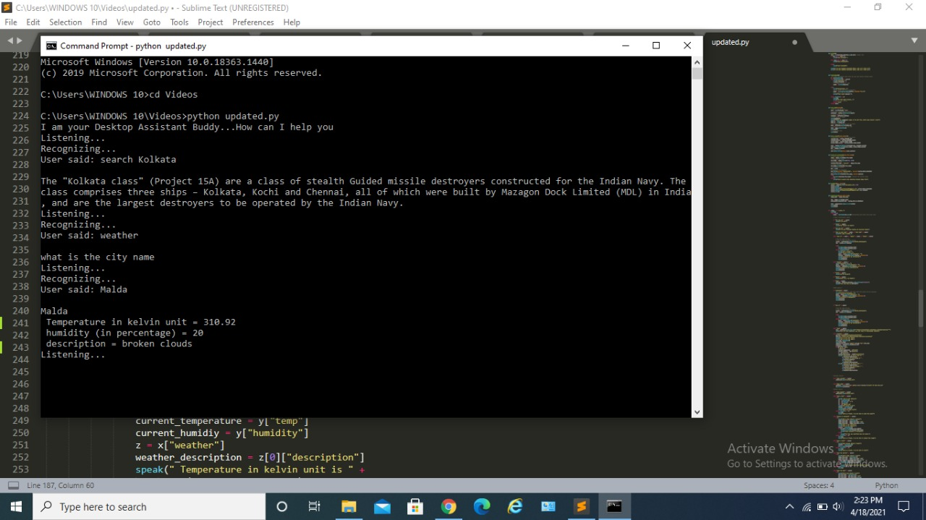
Basic conversations
The assistant is capable of engaging in basic conversations.
It can also tell the user the time and dates.
The assistant is also capable of performing simple arithmetic logic.
The assistant can also inform the user of the weather.

Slide 8
Searching Information
The assistant can search the user queries on relevant search engines like google or Wikipedia.
The assistant also displays the results.

Slide 9
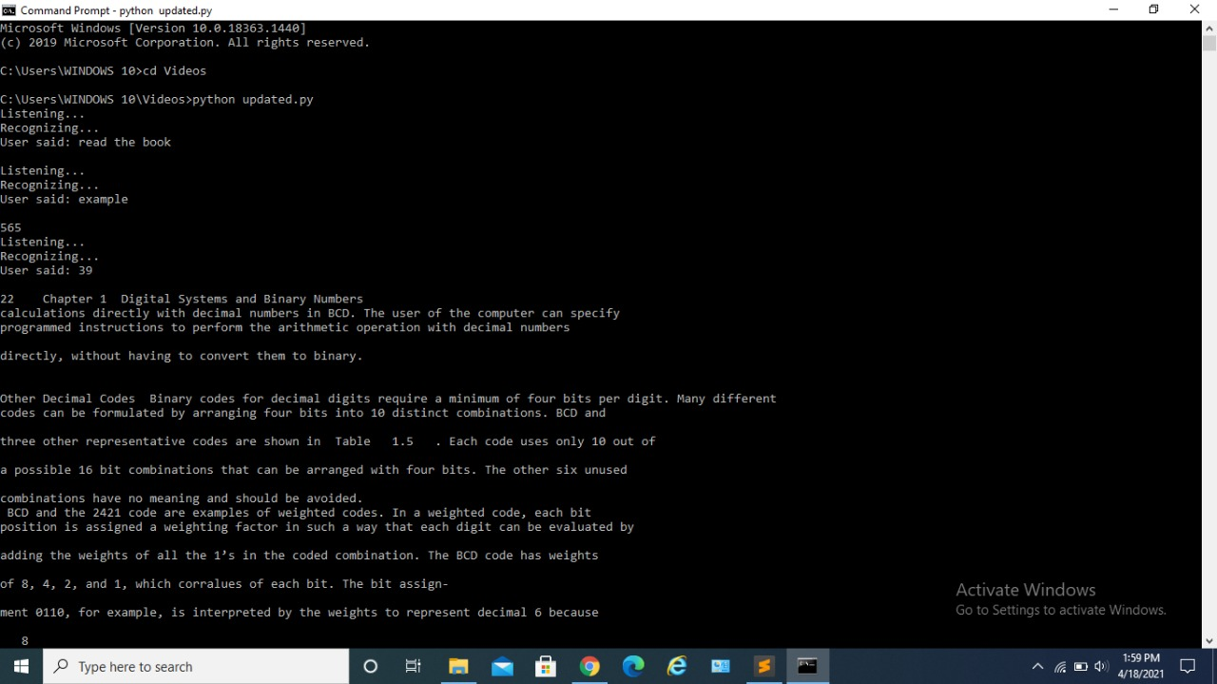
Reading PDF files
The assistant is capable of reading pdf files.
It scans the total page numbers and the user can choose to start from any page

Slide 10
Sending E-mails
The assistant can send E-mails to others through the user's ID.
The E-mails are sent through Gmail.

Slide 11
Offline Tasks
The assistant can play music and open various executable files
The path files can be customized and more can be added through simple coding

Slide 12
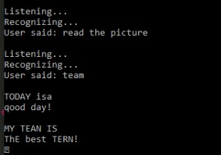
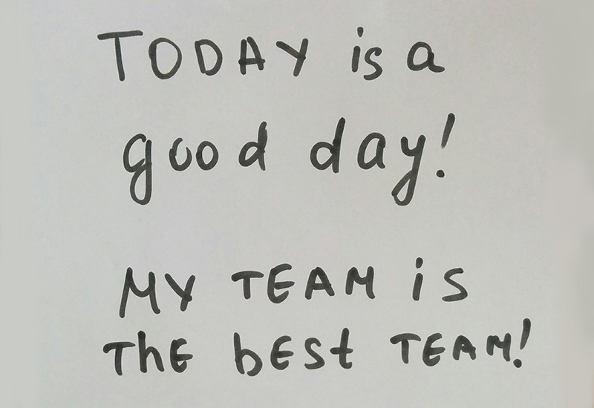
Reading Images
The assistant is capable of reading different formats of images.
Example image.

Slide 13
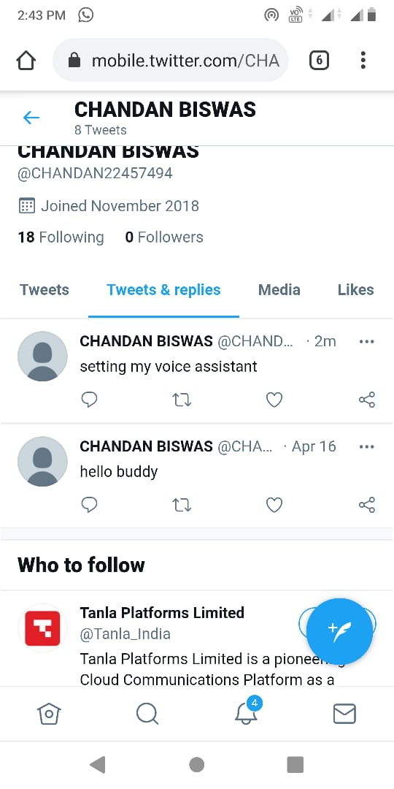
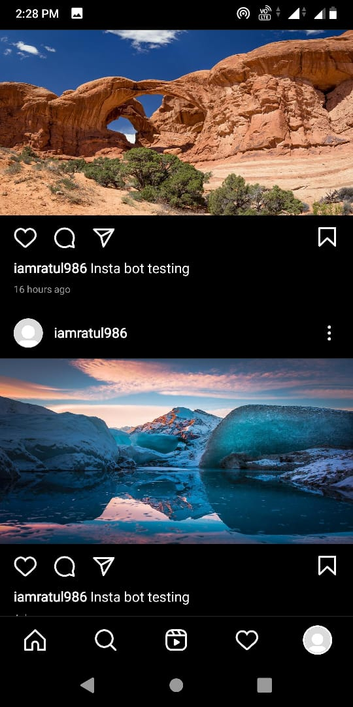
Instagram and Twitter
The assistant can post images to the user's Instagram.
The user can also tweet the user's word to their twitter ID.
Twitter Instagram

Slide 14
Technologies used
Programming language used: python
API and references: Wolframalpha API, Google API (Google Map, Google Weather), Wikipedia API, Cloud computing Wolframalpha system API.
Software application on Desktop OS(Windows): Google chrome/any Internet browser, Google voice recognizing API, TTS Service Extended .
Support application: Anaconda prompt for running source code/ System cmd, module installation code from www.python.org website.

Slide 15
Conclusion
As it has been previous stated, the program mainly concerns with the techniques of Desktop Application development, Python programming, Cloud computing, different APIs for Google products, smart query responder system etc.
In addition, the program which works using the voice is helpful for those who prefer voice operation and those who have difficulty /disability with the manual operations. The primary objective of the program is to provide services using the voice, and it enables more people who can enjoy this program.

